Slide 1
TUTORIAL WEKA
METODE : NAÏVE BAYES

Slide 2

NAÏVE BAYES IN WEKA

Slide 3
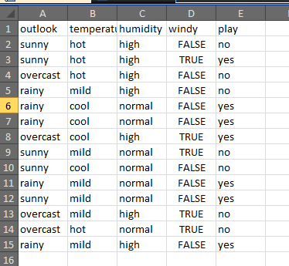

Slide 4
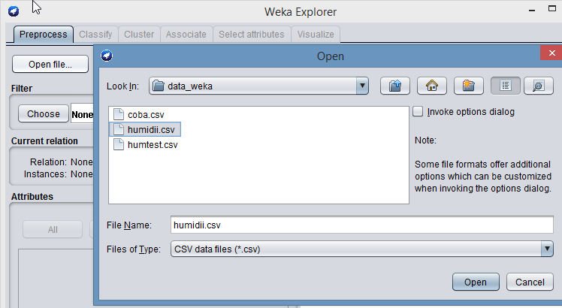
TRAINING

Slide 5
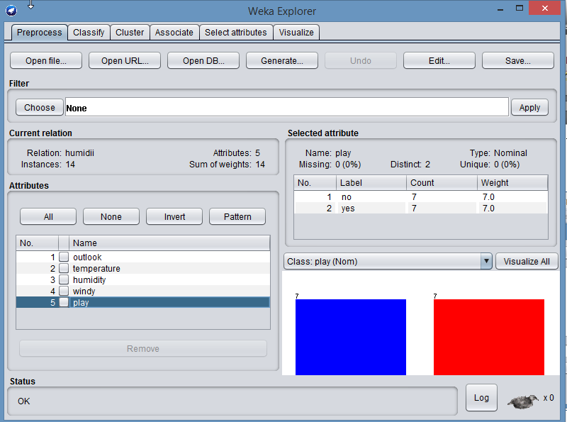

Slide 6
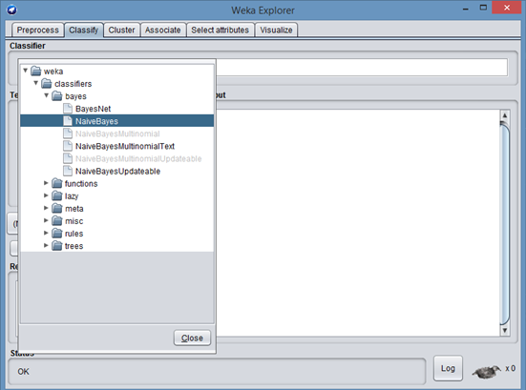

Slide 7
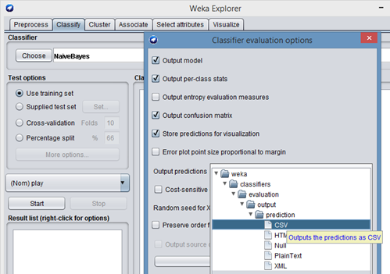

Slide 8
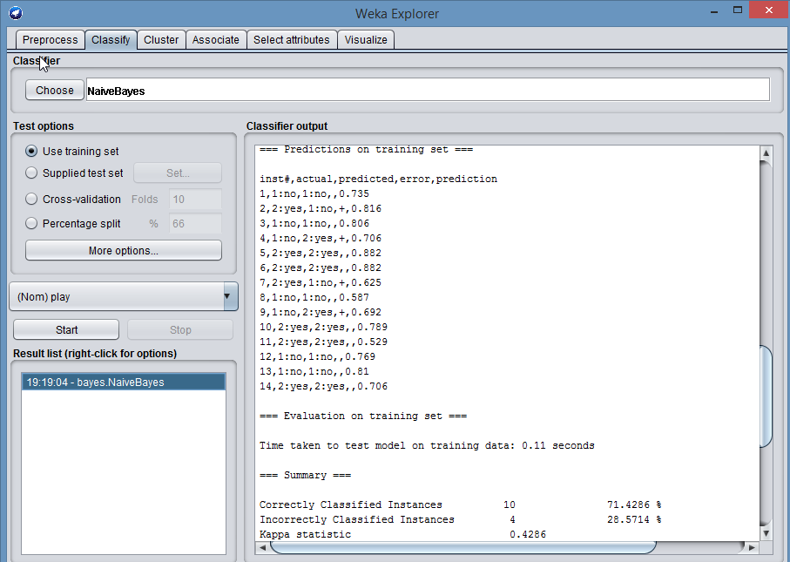

Slide 9
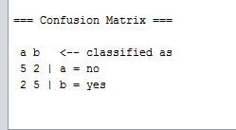

Slide 10
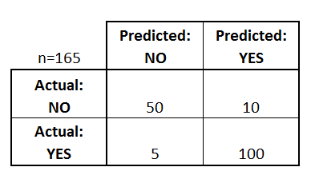
Confusion Matrix
165 patients were being tested for the presence of that disease.
Out of those 165 cases, the classifier predicted "yes" 110 times, and "no" 55 times.
In reality, 105 patients in the sample have the disease, and 60 patients do not.

Slide 11
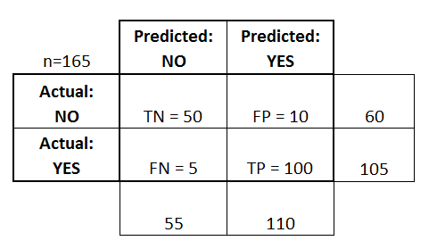
Accuracy: Overall, how often is the classifier correct?
(TP+TN)/total = (100+50)/165 = 0.91
Misclassification Rate: Overall, how often is it wrong?
(FP+FN)/total = (10+5)/165 = 0.09
equivalent to 1 minus Accuracy, also known as "Error Rate“

Slide 12
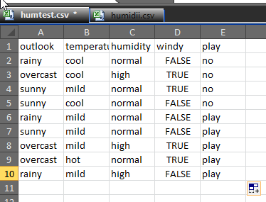
TESTING

Slide 13
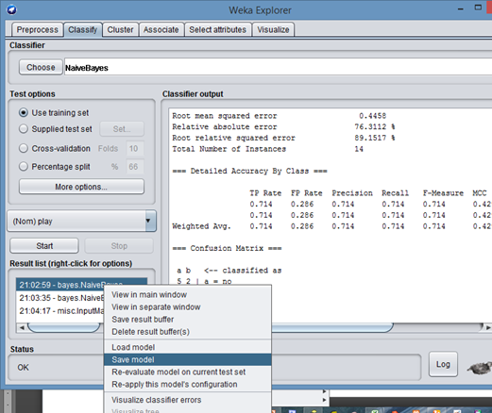
Pada kotak Result List, klik kanan pada bayes NaïveBayes, klik Savel Model.
Simpan pada folder yang sama dengan data training

Slide 14
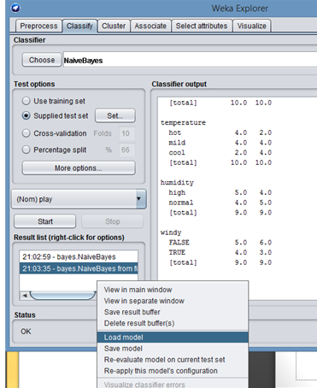
Pada kotak Result List, klik kanan, kmeudian pilih load model.
Pilih file model yang telah disimpan sebelumnya.

Slide 15
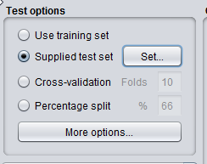
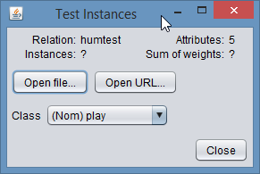
Pada test option
Klik Suplied Test, klik Set

Slide 16
